Slide 1
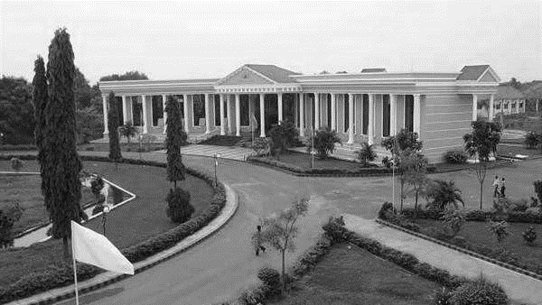



AI VIRTUAL MOUSE USING HAND GESTURE
Presented By:
A.T.ASHOK (510420104015) I I I yr CSE
M.S.AJAY DEV (510420104009) I I I yr CSE
V.CHANDRU (510420104020) I I I yr CSE
J.AASHIP (510420104001) I I I yr CSE
GUIDED BY:
Mr. R.SURESH, M.E.,
AP/CSE
DEPARTMENT OF
CSE

Slide 2
INTRODUCTION
As computer technology continues to develop, people have smaller and smaller electronic devices.
This project is to develop a Virtual Mouse using Hand Gesture Recognition. The hand gestures are the most effortless and natural way of communication.
The aim is to perform various operations of the cursor.
Instead of using more expensive sensors, a simple web camera can identify the gesture and perform the action.
It helps the user to interact with a computer without any physical and hardware device to control mouse operation.

Slide 3
ABSTRACT
The mouse is one of HCI’s (Human Computer Interaction) incredible inventions. A wireless mouse or a Bluetooth mouse are still used. It need a battery for power and a dongle is needed to connect the mouse to the PC.
The proposed AI virtual mouse system can solve this problem by using a webcam or built-in camera to record hand motions and identify hand tips using computer vision.
The computer can be controlled digitally and computer cursor functions based on hand motions without the need for a physical mouse.
As a result, by eliminating human contact and the requirement for external devices to operate the computer, the suggested strategy will stop the spread of COVID-19.

Slide 4
OBJECTIVE
The objective is to perform various operations of the cursor and to be an replacement for the traditional mouse instead of using more expensive sensors.
We introduce a unique Human Computer Interaction approach in this work. A live camera controls how the cursor is moved.
It helps the user to perform left click, right click, double click, drag and drop and multi select operations based on hand motions.
Deep learning method used detect the hands and machine learning concepts used to track and recognize the hand gestures and hand tips
Python language is used which cv2 is the most important package.

Slide 5
LITERATURE SURVEY
In 2016, S. Shetty et al constructed a virtual mouse system using color detection. They used webcam for detecting mouse cursor movement and click events using OpenCV builtin functions.
A mouse driver, written in java, is required as well. This system fails to perform well in rough background. P. C. Shindhe et al. expanded a method for mouse free cursor control where mouse cursor operations are controlled by using hand fingers. They have collected hand gestures via webcam using color detection principles.
The built-in function of Image Processing Toolbox in MATLAB and a mouse driver, written in java, used in this approach.
The pointer was not too efficient on the air as the cursor was very sensitive to the motion. The virtual keyboard has 8 main commands for menu selection to spell 30 different characters and a delete button to recover from error. They evaluated the performance of the system using the speed and information transfer rate at both the command and application levels.

Slide 6
EXISTING SYSTEM
A computer mouse is a hand-held pointing device that detects two-dimensional motion relative to a surface. This motion is typically translated into the motion of a pointer on a display, which allows a smooth control of the graphical user interface (GUI) of a computer.
Mouses are mainly classify into wired and wireless
Wired Mouse
A wired mouse connects directly to your desktop or laptop, usually through a USB port, and transmits information.
Wireless Mouse
A wireless mouse transmit radio signals to a receiver connected to your computer. The computer accepts the signal and decodes how the cursor was moved or what buttons were clicked. While the freedom or range with wireless models is convenient.

Slide 7
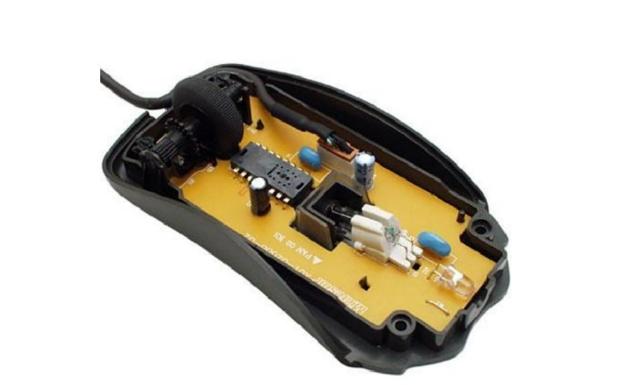
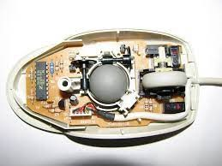
EXISTING SYSTEM
Laser Mouse
The laser mouse is an optical mouse type, and the operating instructions are similar – to sense movement through light reflection. Nevertheless, as the name implies, a laser mouse uses an LED instead of a laser beam. Due to the different light characteristics, the mouse can primarily be used on glass and plastic surfaces, although it is not practical.
Trackball Mouse
Anything like the upside-down ball mouse is a trackball mouse. It senses movement by rotating the ball with the thumb or palms of the hand rather than turning the cursor around.
Bluetooth mouse
Wireless mouse is more responsive and accurate. The Bluetooth mouse is slightly slower than the wireless one. It needs an extra USB adapter to receive radio frequency. It doesn't need any USB adapter if you have a built-in Bluetooth function on your computer or laptop.

Slide 8
PROBLEM STATEMENT
In our laptops, sometimes touchpad are not functions properly. Because of touchpad are often using, that will reduce the quality of sensor.
Physical mouse require special hardware and surface to operate
All wired and wireless mouse have its own lifespan
The users need to colour their fingers with a specific color and required to use any device or sensors.
Our personal computers mouse are not operate properly in the time of no full surface ground for mouse, any damages occurs in mouse wire and some other issues on inbuild mouse etc.,

Slide 9
PROPOSED SYSTEM
The AI virtual mouse system is useful for many applications, it can be used to reduce the space for using the physical mouse, and it can be used in situations where we cannot use the physical mouse. The system eliminates the usage of devices, and it improves the human-computer interaction.
To control our screen, the user moves the finger which will work as cursor. To make this possible three main algorithms needed that are mediapipe, OpenCV and autopy.
Rectangular Region for moving through the Window. The AI virtual mouse system makes use of the transformational algorithm, and it converts the coordinates of fingertip from the webcam screen to the computer window full screen for controlling the mouse.
Webcam is a necessary component for detecting the image. Sensitivity of mouse is directly proportional to resolution of camera.

Slide 10
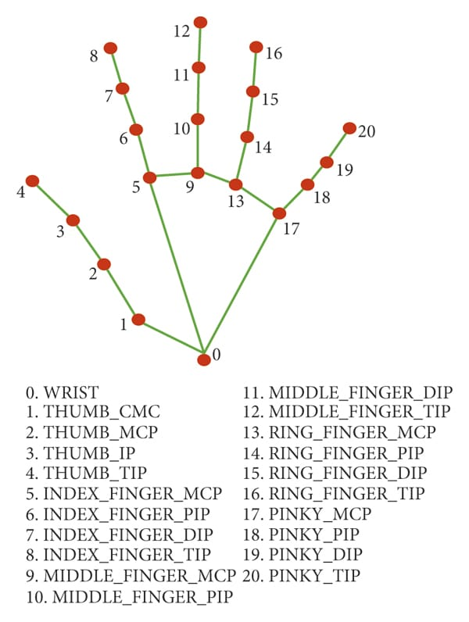
WORKING METHODOLOGY
A virtual mouse that can be controlled using hand gestures typically relies on computer vision techniques and gesture recognition algorithms. Here's a general overview of how such a system might work:
Hand Detection: The system needs to detect and track the user's hand in real-time. This can be achieved using a camera or depth sensor, such as a webcam or a depth-sensing device like Microsoft Kinect. Various computer vision techniques like background subtraction, skin color detection, or hand shape analysis can be used to identify the hand region in the captured video frames.
Hand Tracking: Once the hand is detected, the system tracks its movement over time to determine its position and velocity. This involves continuously analyzing subsequent frames and identifying the hand's key points or landmarks (e.g., fingertips, palm center) using techniques like feature extraction, template matching, or machine learning-based methods.

Slide 11
WORKING METHODOLOGY
Gesture Recognition: The system needs to interpret the hand movements and recognize specific gestures. Gesture recognition algorithms analyze the spatial and temporal patterns of the hand's key points to classify them into predefined gestures. Machine learning techniques, such as c K-nearest neighbor (KNNs), can be used for this purpose. The gestures can be designed to represent mouse movements (e.g., moving the hand left/right, up/down) or mouse actions (e.g., clicking, dragging).
Mouse Control: Based on the recognized gestures, the system translates them into corresponding mouse actions. The virtual mouse's position can be updated based on the hand's movements, such as mapping the hand's position to the screen coordinates. For example, moving the hand to the right can move the mouse cursor to the right on the screen. Similarly, gestures representing clicking, dragging, or scrolling can be translated into corresponding mouse events

Slide 12
SYSTEM SPECIFICATION
HARDWARE REQUIREMENTS :
System : Pentium IV 2.4 GHz.
Hard Disk : 40 GB.
Monitor : 15 VGA Color.
Ram : 512 Mb.
Webcam : 720p HD Webcam.
SOFTWARE REQUIREMENTS :
Operating system : Windows 8 or above is needed
Coding Language : PYTHON
Tool : ANACONDA
Libraries : Opencv, Mediapipe, Numpy

Slide 13
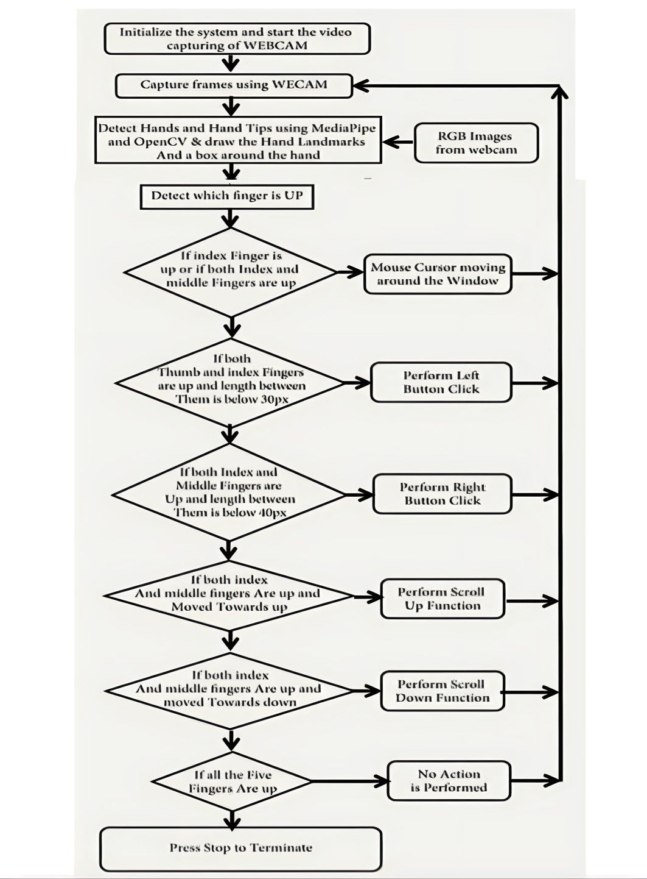
FLOW CHART

Slide 14
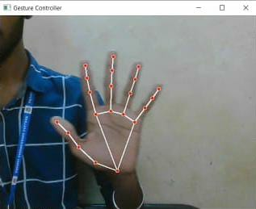
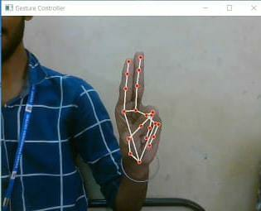
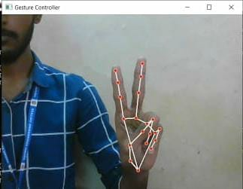
RESULTS
Some gestures of this Virtual Mouse project…
No Movement of cursor
Double Click
Cursor will be move

Slide 15
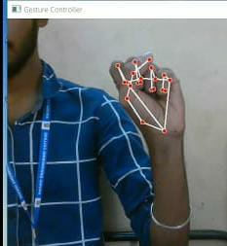
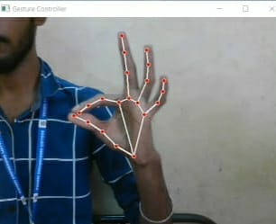
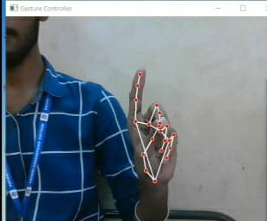
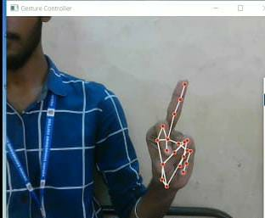
RESULTS
Stop the program
Multi select
Right click
Left click

Slide 16
ADVANTAGES
Provides greater flexibility then the existing system.
Much easier to adapt.
Less prone to the physical damage and mechanical wear and tear.
Avoidance of mouse related wrist damage like CTS, RSI.
It can be used to reduce the space for using the physical mouse.
It avoid contact things, which helps to decrease the possibilities of spreading COVID.

Slide 17
FUTURE ENHANCEMENT
In the future, we plan to add features like enlarging and shrinking windows, etc. by using the palm and multiple fingers.
To open the browser or any drives with the help of hand gestures instead of moving gesture.
There are several features and improvements needed in order for the program to be more user friendly, accurate, and flexible in various environments. The following describes the improvements and the features required.
a) Smart Movement
b) Better Accuracy & Performance
c) Mobile Application

Slide 18
CONCLUSION
The main objective of the AI virtual mouse system is to control the mouse cursor functions by using the hand gestures instead of using a physical mouse. The proposed system can be achieved by using a webcam or a built-in camera which detects the hand gestures and hand tip and processes these frames to perform the particular mouse functions. It can be used to reduce the spread of COVID-19, since the proposed mouse system can be used virtually using hand gestures without using the tradtional physical mouse. The model has some limitations on accuracy and in some functions. Hence, we will work next to overcome these limitations by improving the finger tip detection algorithm to produce more accurate results.

Slide 19
THANK YOU
DEPARTMENT OF
CSE

